Slide 1
Distracted Driving / Defensive Driving

Slide 2

Introduction
Your Presenter:
Jake Plevnic, MBA, CSP, CHST
Construction Loss Control Consultant
Lockton Companies
Jacob.plevnic@lockton.com
An electronic copy of this presentation is available to you
This is informal – ask questions at any time

Slide 3

Today’s Discussion
Distracted Driving
Defensive Driving
Misc. Auto Safety Related Topics

Slide 4
Distracted Driving

Slide 5
A look back in history:
This study was published in 2006!
Source: (NHTSA-100 Car Naturalistic Driving Study 2006)

Slide 6
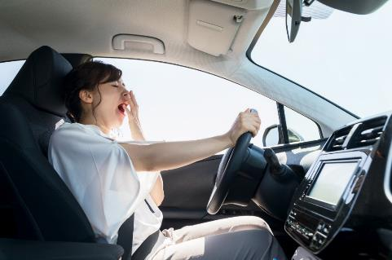
Fatigue / Drowsy Driving
Additional studies in 2006 and 2010 found:
12% of all crashes and 10% of all near-crashes involved drowsy driving.
11% of drivers surveyed said they had fallen asleep while driving during the past year.
100,000 crashes were caused by drowsy driving, resulting in 40,000 injuries and 1,550 deaths.
Source: Virginia Tech Transportation Institute 100-Car Study, 2006 AAA Foundation for Traffic Safety Survey of 2,000 drivers, 2010.
Notes:
5

Slide 7



Distracted Driving Statistics – 2015
One of the top three causes of accidents
3,477 deaths directly related to distracted driving
391,000 people injured by distracted driving
25% of crashes involve talking or texting on cell phones
47% of drivers say they are comfortable texting manually or through voice controls while driving
50% of the driving environment is unobservable to a driver using a cell phone while driving (handheld or hands-free)
Source: National Safety Council

Slide 8

Cellular Phone Ownership
In 2011 approximately 92.8 million people owned SMART phones
By 2018 this number increased to 224.3 million
The 2018 U.S. population was 326 million
This is expected to grow to 271 million by 2022

Slide 9
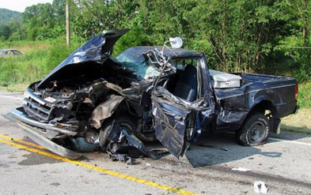
Distracted Driving Statistics – Today
In the U.S., approximately 9 people are killed and 1,000 others injured each day as a result of crashes involving a distracted driver.
Since there is no way to test for distracted driving after an accident occurs, it’s widely believed that the number of crashes, injuries, and fatalities caused by distracted driving are vastly under reported.
Source: Centers for Disease Control and Prevention
https://www.cdc.gov/motorvehiclesafety/distracted_driving/index.html

Slide 10
By comparison…
Next level falls are the #1 leading cause of fatalities in the U.S. construction industry….every year.
Between 150 and 200 workers are killed each year, as a result of a fall.
Again, 9 people are killed every day in the U.S. because of distracted driving.
Work related vehicular driver fatalities don’t even have to be reported to OSHA (only one exception: if the fatal incident occurs in a construction work zone).

Slide 11

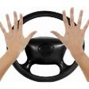

What is Distracted Driving?
Answer: Operating a motor vehicle while engaged in other activities:
Visual - Taking your eyes off the road
There are three types of distractions that can impact driving behavior
Manual - Taking your hands off the wheel
Cognitive - Taking your mind off of driving
Source: National Highway Traffic Safety Administration (NHTSA)

Slide 12
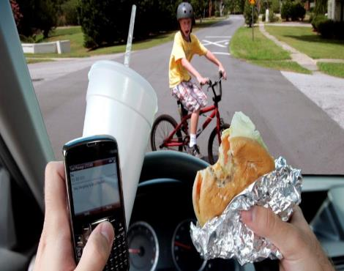
Distractions While Driving
Cell phones
Pedestrians
Attitude/mood
Food/drink
Unknown surroundings
Passengers
Billboards
Accidents
Reaching for object
Dashboard adjustments

Slide 13
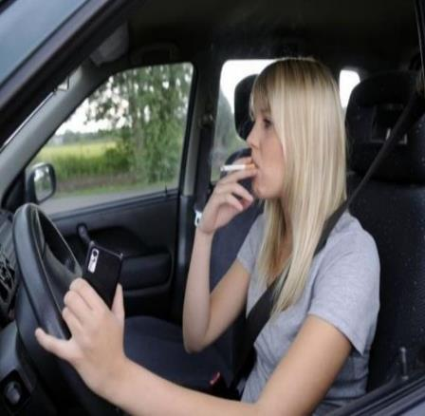
Distractions While Driving – cont…
Music
Road signs
Insects/bugs
Scenery
Smoking
Reading
Personal grooming

Slide 14
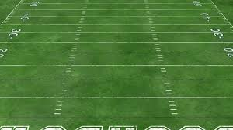
Consider this:
When sending a text message while driving, the average person looks away from the road for 5 seconds.
If you are texting and driving at 55 MPH, you could travel the length of a football field without looking at the road.

Slide 15
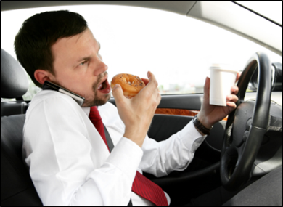
Common Events While Driving Distracted
Miss turn
Leave lane of travel
Run stop light
Tailgate other vehicles
Speed
Too fast for conditions
Rear-end collision
Hard brake event
Luck

Slide 16
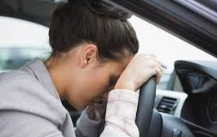
Conditions That Affect Driving Ability
Medication
Hearing
Mobility
General physical health
Stress
Emotions
Attitude
Vision

Slide 17
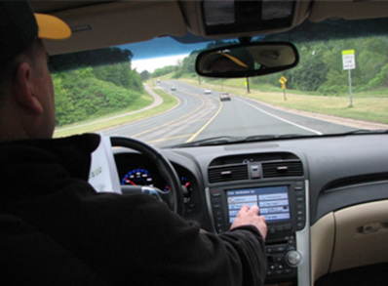
Ever listen to crash victim interviews?
“I didn’t think it would ever happen to me.”
“The truck came out of nowhere!”
“I just looked away a couple seconds.”
“Looking back, that text message wasn’t worth it.”

Slide 18
How does the normal “hierarchy of hazard controls” apply to distracted driving?
Most Preferred
Least Preferred
1st:
Engineering Controls
2nd: Administrative Controls
3rd :
Work Practice Controls
4th: Personal Protective Equipment
Vehicle design
Safety features
Company policy
Driver training
Attentive driving
Traffic law compliance
Air bags
Seatbelts
The driver is the primary key in this case!

Slide 19
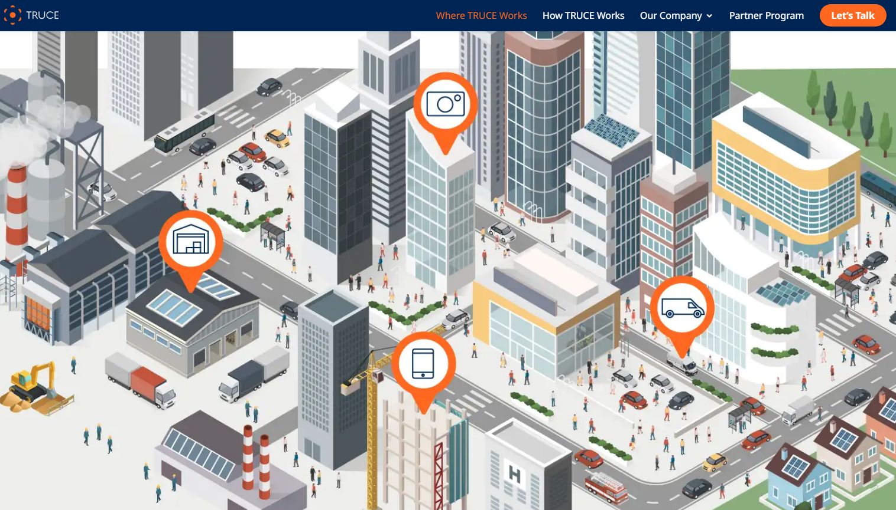
Combatting Distracted Driving with Technology
https://trucesoftware.com/

Slide 20


How can we, as drivers, stay focused on the task of driving?
Make a personal commitment to not be distracted while driving.
Plan for distraction avoidance.
Follow all traffic laws.

Slide 21
Defensive Driving

Slide 22
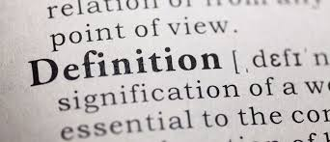
What is “Defensive Driving”?
While the term can vary from state to state, defensive driving is both a style of driving and a type of safety course drivers can take.
According to the National Safety Council, the term “defensive driving” means:
"driving to save lives, time, and money, in spite of the conditions around you and the actions of others."

Slide 23
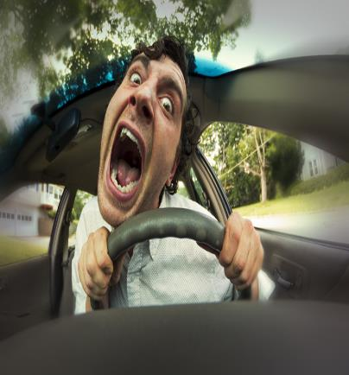
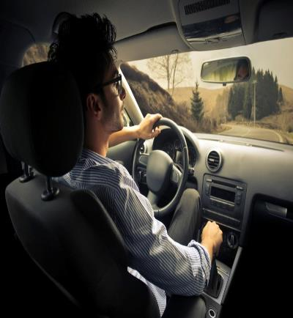
There are three types of drivers – which one are you?
Offensive
Defensive

Slide 24
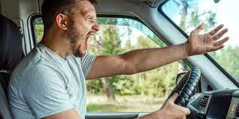
Types of drivers – cont…
Offensive Driver who thinks they are Defensive!

Slide 25
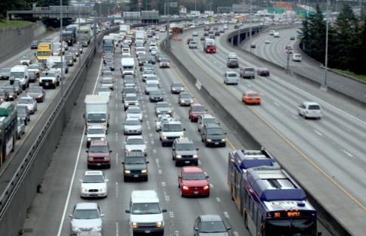
Defensive Driving Plan
Create your space
Recognize the hazards
Understand the defense
Act correctly, in time

Slide 26
5 Step Formula for Safe Driving
Look far ahead of your vehicle
Maintain a wide view
Know what is ahead and behind your vehicle
Always have an escape plan
See and be seen

Slide 27
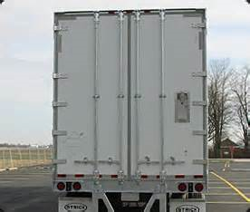

Defensive Driving Plan – cont…
Look far ahead of your vehicle:
13 to 16 seconds
Avoid situations that inhibit your vision

Slide 28

Defensive Driving Plan – cont…
Maintain a wide view:
Move eyes continuously
Scan area for hazards
Avoid fixed stares – cone vision will result

Slide 29
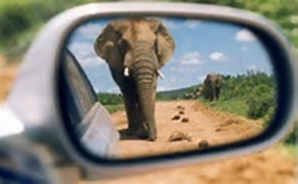
Defensive Driving Plan – cont…
Know what is ahead and behind your vehicle:
Check mirrors every 4 to 7 seconds
Be aware of your vehicle's blind spots
Avoid clusters
Create space
Maintain at least 2 seconds of following distance in good weather

Slide 30
Defensive Driving Plan – cont…
Always have an escape plan:
Create space between you and other vehicles
Anticipate the unsafe actions of others
Plan for your exit upon entering

Slide 31
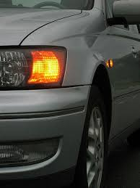
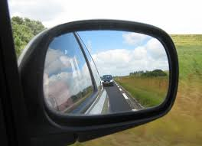
Defensive Driving Plan – cont…
See and be seen:
Lights
Turn Signals
Mirrors
Windshield
Horn

Slide 32
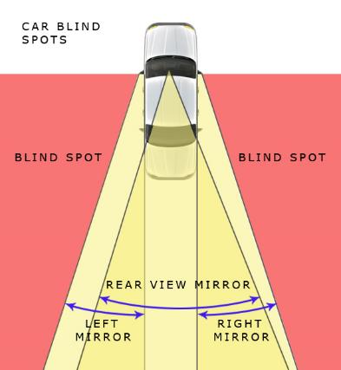
Blind Spots
Areas to the side of your car that can’t be seen in your mirrors
Know where the blind spots are on your own vehicle
Quick look over your shoulder
Engage turn signal long before changing lanes
Minimize time spent in other drivers’ blind spots

Slide 33
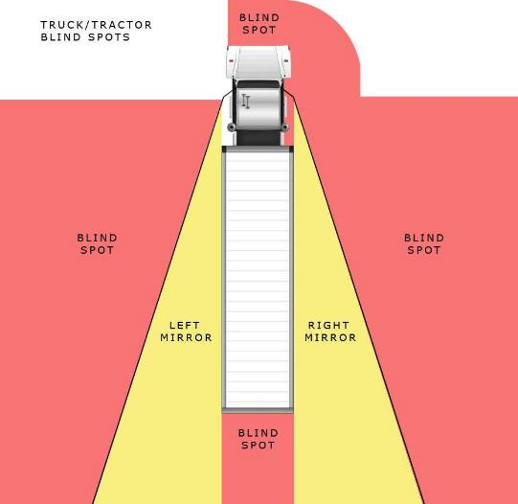
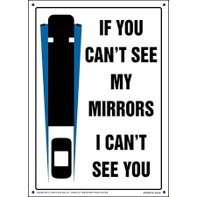
Truck Blindspots

Slide 34
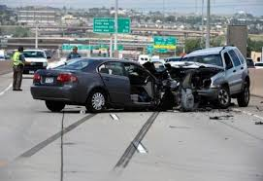
Why Collisions Occur
Inattention
Not enough time
Not enough space
Others’ mistakes
Failure to adjust to conditions
Attitude/emotions

Slide 35
Following Distance

Slide 36
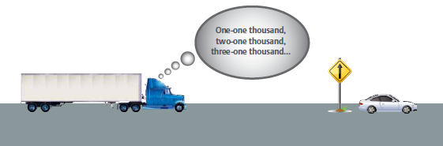
Measure Following Distance in Seconds

Slide 37
How Much Space Do You Need?
Answers:
2-4 seconds minimum – Passenger vehicles, light vans, pickups
4-6 seconds – Utility trucks, box trucks, straight trucks and autos or pickups towing trailers
6-8 seconds – Heavy trucks, buses, & tractor trailer rigs
Increase following distances under adverse conditions

Slide 38
Total Stopping Distance
In front of the vehicle:
Perception Time: The seconds of time required to identify a problem.
3/4 second or more
Reaction Time: The seconds of time it takes a driver to lift his/her foot off the accelerator pedal and apply the brake pedal.
3/4 second or more
Braking Distance: The distance needed to actually stop the vehicle. (varies by vehicle size and weight, brake system, etc.)

Slide 39
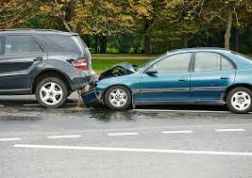
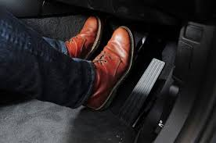
Total Stopping Distance – cont…
Automobile traveling at 30 mph:
Perception Distance 33 feet
Reaction Distance 33 feet
Braking Distance 43 feet
Total stopping distance = 109 feet
Automobile traveling at 65 mph:
Total stopping distance = 344 feet
Over 3 times the distance!

Slide 40
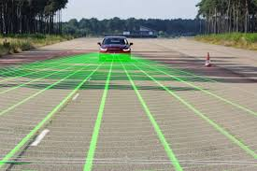
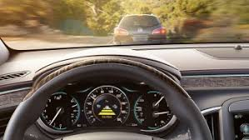
Car Manufacturers’ Following Distance Technology
Automatically maintains a safe distance between you and traffic ahead
Helps prevent rear-end collisions
Distances can be adjusted, or system turned off completely

Slide 41
Speeding

Slide 42
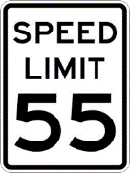
Speeding – cont…
Driving the “speed limit” is not always safe…
Conditions affecting speed management are:
1. Reduced visibility.
2. Reduced traction from adverse weather conditions.
3. Curves / blind spots.
4. Downgrades.
5. Pedestrians / congestion.

Slide 43

Question: Why do people speed?
Get there faster
Keeping up with traffic
To pass another driver
Beat other vehicles to the next light or exit

Slide 44
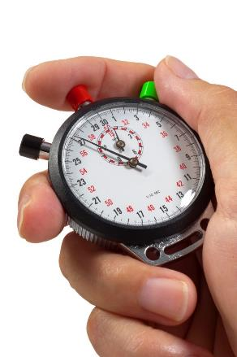
Speeding – cont…
How much time is saved?
What is the risk?
What are some potential consequences?
Is it worth the risk?

Slide 45
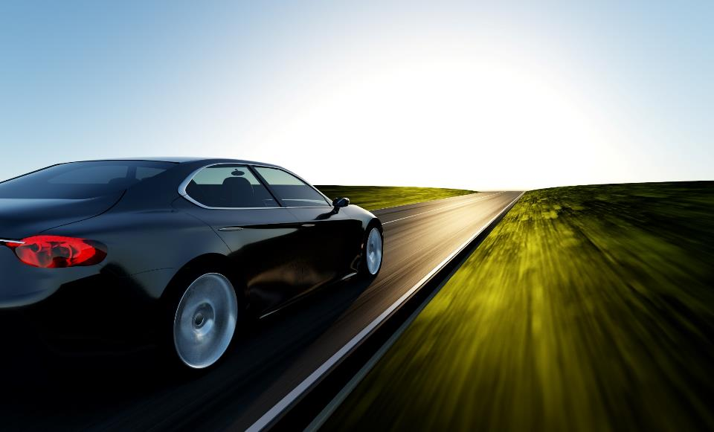


How much time do we actually save?
60
65
Arrival Time = 5 Minutes Difference!

Slide 46
Seat Belts

Slide 47
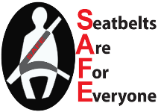
Seat Belts Save Lives!
One of the safest choices drivers can make is to buckle up.
In 2016, seat belt use in passenger vehicles saved an estimated 14,668 lives.
The national use rate is at 90.1 percent –nearly 27.5 million people still don’t buckle up!
Of the 37,461 people killed in motor vehicle crashes in 2016, 48 percent were not wearing seat belts.
If you buckle up in the front seat of a passenger car, you can reduce your risk of:
Fatal injury by 45 percent
Moderate to critical injury by 50 percent
If you buckle up in a light truck, you can reduce your risk of:
Fatal injury by 60 percent
Moderate to critical injury by 65 percent
Source: National Highway Traffic Safety Administration, https://www.nhtsa.gov/risky-driving/seat-belts

Slide 48
Seat Belts – cont…
Drivers wear seatbelts because:
Seatbelts keep them in the seat to control the vehicle
They help keep them from being ejected
Are you in the 10%?

Slide 49
Choices

Slide 50

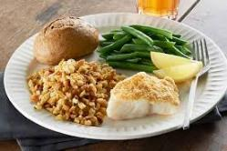






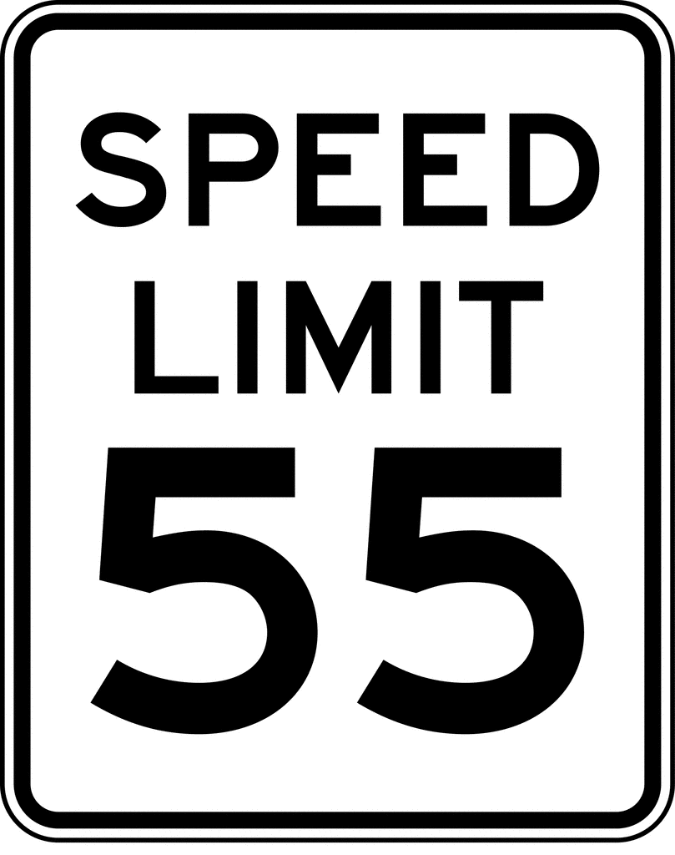


Choices…we make thousands of them every day.

Slide 51
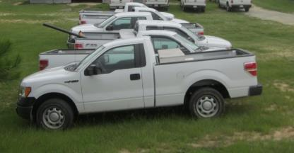
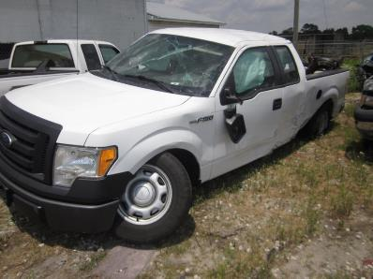
Choices – cont…
This driver didn’t choose to crash the vehicle that day!
Before
He/she made the wrong choice(s) which led to this.
After

Slide 52
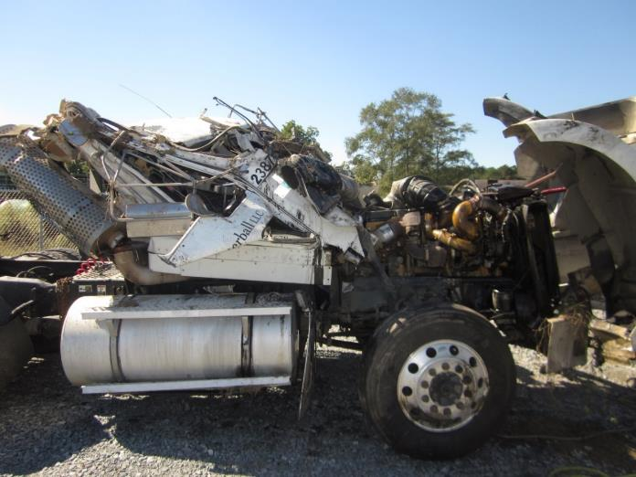
…and sometimes the outcomes are much worse.

Slide 53

Company image can be tarnished as well!

Slide 54

Driving is a Choice…..Drive it Home!!!
Distracted driving
Defensive driving
Following distance
Speeding
Seat belts
How do you choose to drive?

Slide 55

Bottom line…
It takes a personal commitment to consistently drive safely
Lead by example!

Slide 56

Who benefits from safe driving?
EVERYONE !!!
Employees
Employees’ families
Employers
General public

Slide 57
Popular 3rd Party Driver Training
Smith System
National Safety Council - Training kits, online training, in-class training
JJ Keller – Training Kits, Videos
Click Safety – Online driver training
UL Pure Safety – Online training
Pro-Tread Driver Training – Online training primarily for regulated fleets
Infinit-i Workforce Solutions - Online training primarily for regulated fleets

Slide 58
Questions?
DISCLAIMER. The information provided, and services performed, are being disclosed and/or undertaken with the express understanding and agreement that Lockton is not engaged in rendering legal services. Accordingly, the information provided, and services performed, are not intended to serve as legal advice, and should not be construed as such.

